Slide 1

Implementation of LMS FIR based Adaptive Filter for System Identification
Presented by: Tushant
Submitted to: Prof. Christof Jonietz

Slide 2
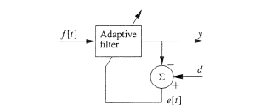
Background
What is Adaptive Filters?
An adaptive filter is a filter, usually with an FIR impulse response, in which the coefficients are obtained by attempting to force the output of the filter y [n] to match some desired input signal d[n].
What is LMS FIR?
LMS FIR Means Least mean square with finite impulse response. Here, we are going to use the Gradient Based Optimization for FIR-Based Adaptive Filters. And LMS based FIR is one of the gradient-based Optimization method.

Slide 3
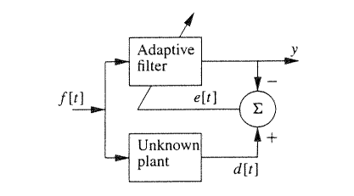
Why system identification required?
Using an adaptive filter we can estimate the transfer function of an unknown plant, using the configuration shown in figure below.
Estimating the transfer function
means knowing the number of
Coefficients and values of the filter
coefficients of unknown plant.
And ultimately, we can predict the
behavior of the unknown system.

Slide 4
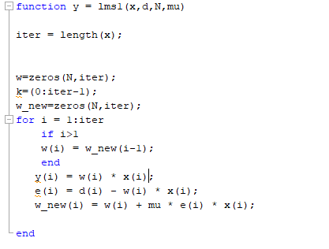
Implementation on Matlab
Task1 : Implementation of LMS algorithm for N(number of coefficients)=1 and test for different step sizes and plot the graph for y[k]- filter output, d[k]- desired signal and x[k]- input signal.

Slide 5
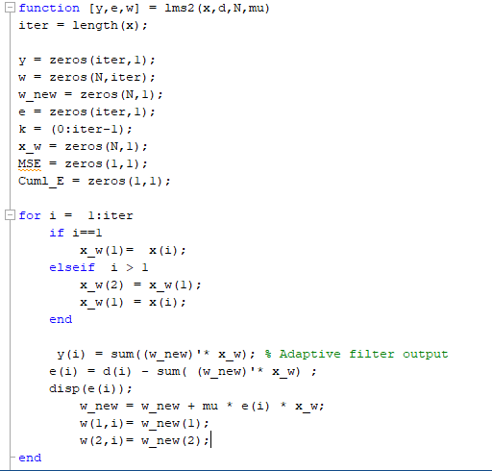
Task2: This task is dividing in three parts
plot the squared error e2 [k] (learning curve).
Compare the learning curves with and without noise.
Examine the convergence behavior of the filter coefficients plot w1=f(w2).

Slide 6
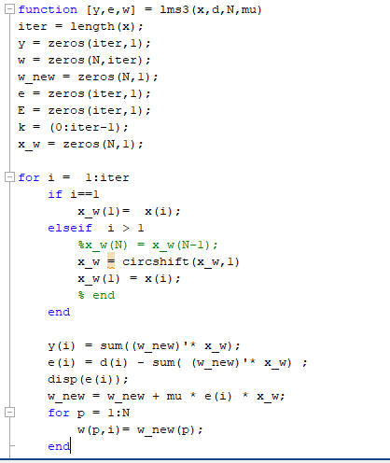
Task3: This task is divided into three subtasks.
Loading the ‘.mat’ file in the matlab code for feeding x and d values.
Using system identification, estimate the length(L) of unknown system’s coefficients.
Using system identification, estimate the value of the unknown system’s coefficients i.e. h.
Note: N and mu(stepsize) can change, so the code should be generic.

Slide 7
DEMO

